Slide 2
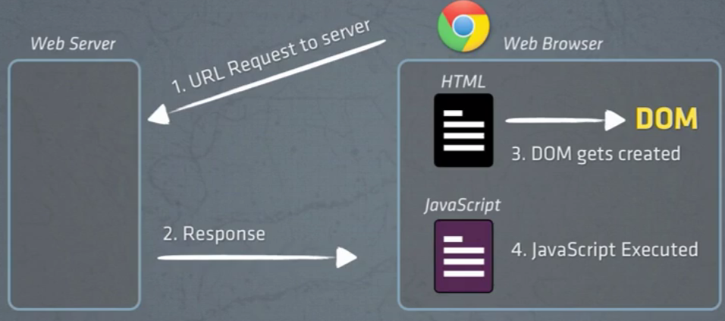

Slide 3
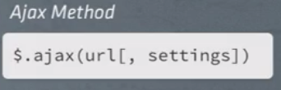
AJAX asynchronous js n xml
A way to communicate wid web server widout doing a full page refresh . To fetch more data into already loaded page dynamically
A client side technique fa communicating wid a web server
AJAX is the art of exchanging data with a server, and updating parts of a web page - without reloading the whole page. loading data in the background and display it on the webpage, without reloading the whole page.
Examples of applications using AJAX: Gmail, Google Maps, Youtube, and Facebook tabs.
With the jQuery AJAX methods, you can request text, HTML, XML, or JSON from a remote server using both HTTP Get and HTTP Post - And you can load the external data directly into the selected HTML elements of your web page
(Writing regular AJAX code can be a bit tricky, because different browsers have different syntax for AJAX implementation. This means that you will have to write extra code to test for different browsers. However, the jQuery team has taken care of this for us, so that we can write AJAX functionality with only one single line of code.)

Slide 4
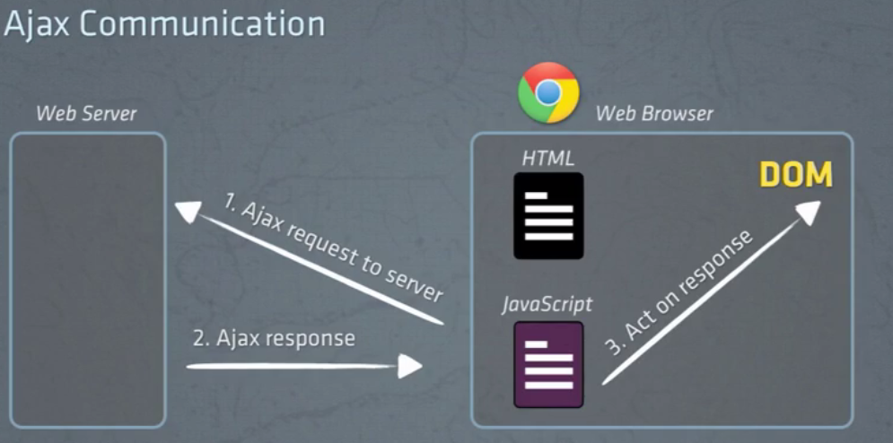
Wid ajax
Browser has already loaded the webpage into the DOM but we wanna get additional data from the server. So from inside the javascript we make an ajax request to the server and den the web server sends an ajax response which can be an html o another data format den

Slide 5
Ajax stands for Asynchronous JavaScript and XML. Ajax is not a single technology; it is a suite of several technologies. Ajax incorporates the following:XHTML for the markup of web pagesCSS for the stylingDynamic display and interaction using the DOMData manipulation and interchange using XMLData retrieval using XMLHttpRequestJavaScript as the glue that meshes all this together
Ajax enables you to retrieve data for a web page without having to refresh the contents of the entire page. In the basic web architecture, the user clicks a link or submits a form. The form is submitted to the server, which then sends back a response. The response is then displayed for the user on a new page.
When you interact with an Ajax-powered web page, it loads an Ajax engine in the background. The engine is written in JavaScript and its responsibility is to both communicate with the web server and display the results to the user. When you submit data using an Ajax-powered form, the server returns an HTML fragment that contains the server's response and displays only the data that is new or changed as opposed to refreshing the entire page.
Show flipkart example

Slide 6
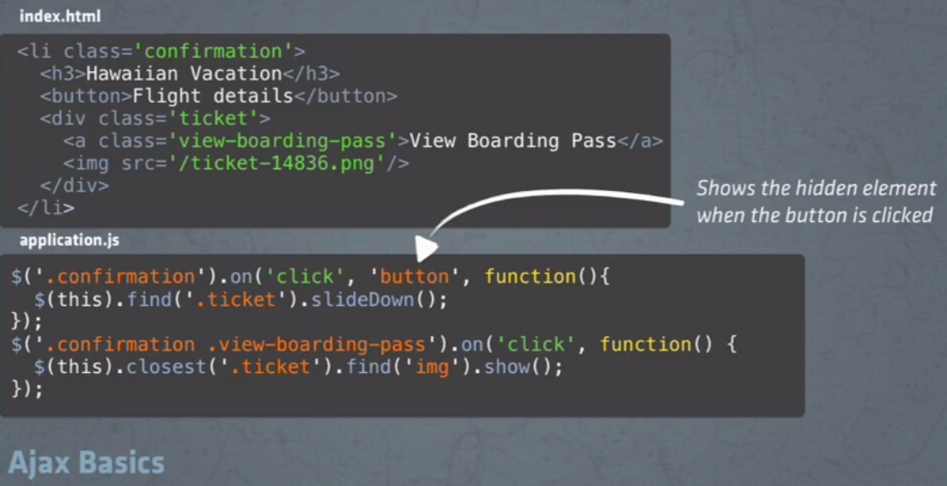
Ex 1 without ajax

Slide 7
HTTP
The Hypertext Transfer Protocol specifies how a client machine requests information or actions from servers. This protocol specifies how two machines share information, which is called a request.
URI: A URI or Uniform Resource Identifier is how objects are identified. Clients use URIs to tell the server what object to act on for a given request. In more general terms a URI is nothing more than a web address.
VERBS: GET - how a client machine tells a server that it wants information about the item identified by the URI. Because GET requests are all about asking for information
POST
PATCH - how a client tells a server it wants to modify an object identified by the URI the request is sent to.
DELETE - as you might guess, how a client tells a server to remove an object identified by the URI the request is sent to.

Slide 8
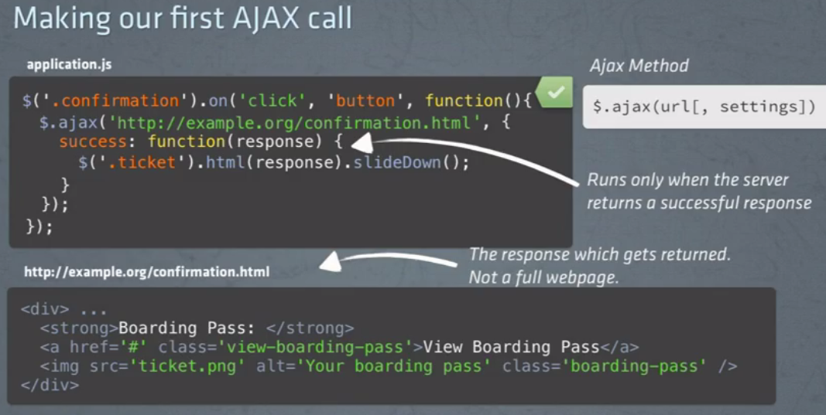
Ex 1 wid ajax
First param is the url and the second is the js object which contains an option cald success. This is the success callback. This is wer we tell our browser watta do if the response to the req is successful
In success we find the ticket div and load the html from the response(ajax load can b seen on dev tools)
url can be relative, cuz by default the ajax we r calling will use the same domain that yo browser has loaded. The ajax call made is displayed on the console.
After this we have to add another event $(‘.confirmation .view-boardingg-pass’) which is done in later slides. It wont work until some changes r done(better avoid this functionality in all fa the training)

Slide 9
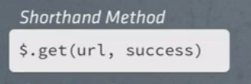
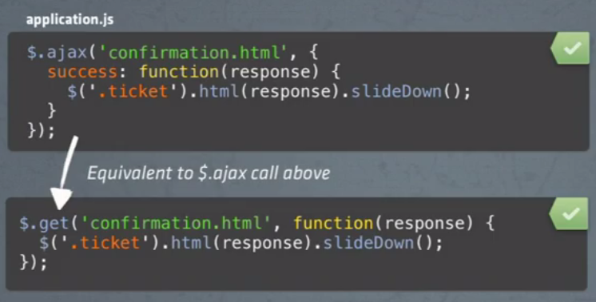
$.get instead of $.ajax
Takes oly 2 parameters : url and the success

Slide 10
Data attr along wid url not doing(1st vid)

Slide 11
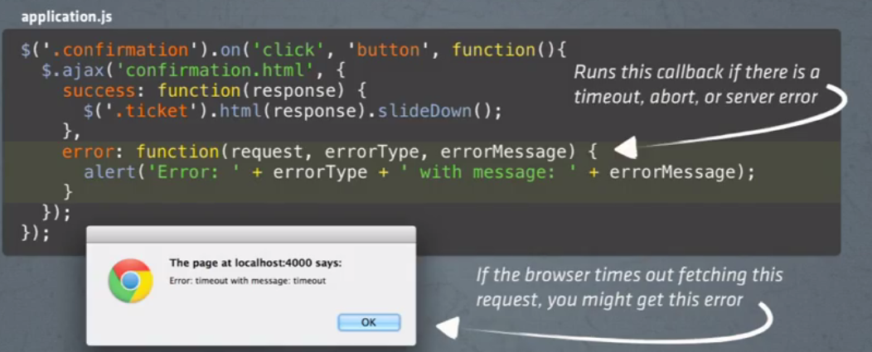
Failed ajax requests wid error callback
Wen ders timeout, abort or server error

Slide 12
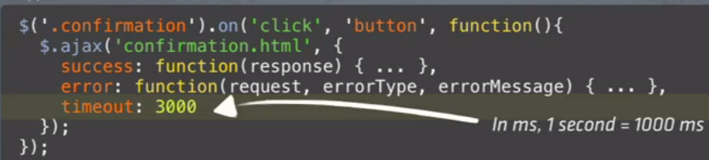
How long does it take to timeout? It defers fa diff browsers thus it is better to set a timeout before calling the error callbacks

Slide 13
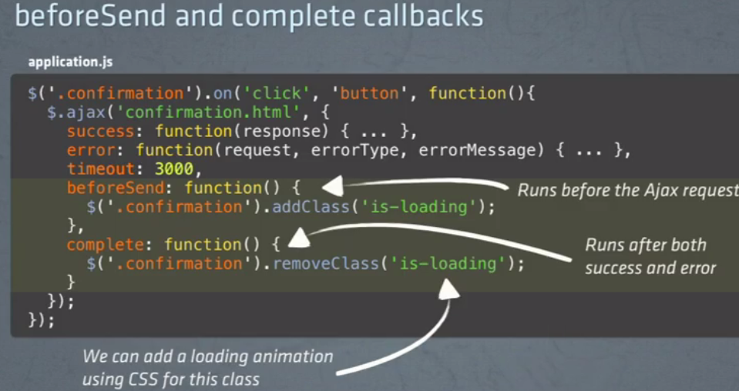
Two other callbacks

Slide 14
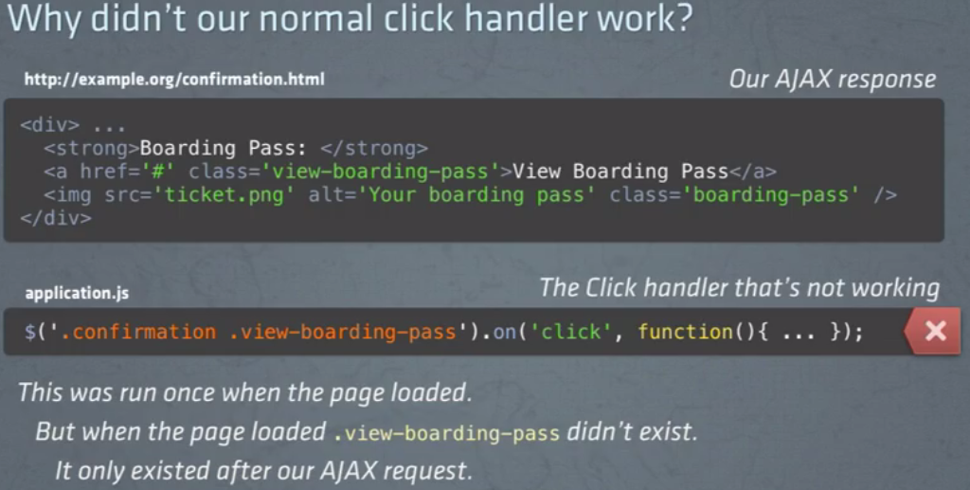
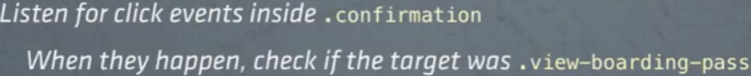
The link in the ajax response dosn work becuzapp.js was run wen the page was loaded. the view-boarding-pass was not available until the ajax call was actually made and that is wen we have to use event delegation

Slide 15
3rd video js objects not doing
Init method , refactoring n organising
4th video js funtions (not doing)

Slide 16
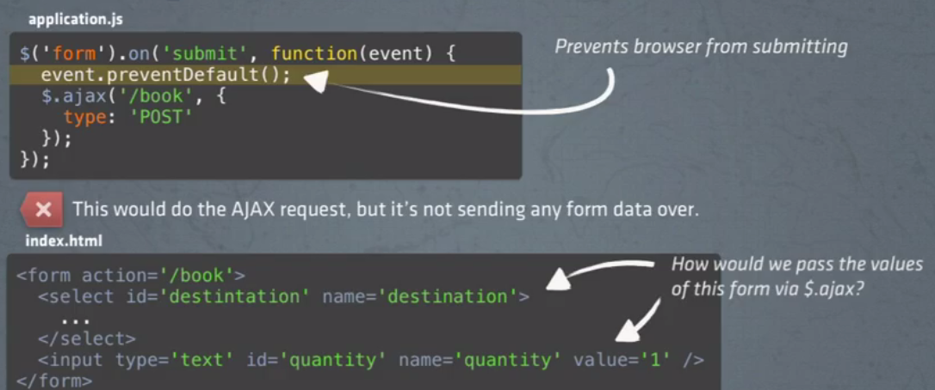
AJAX forms(refer elswer fa better example)

Slide 17
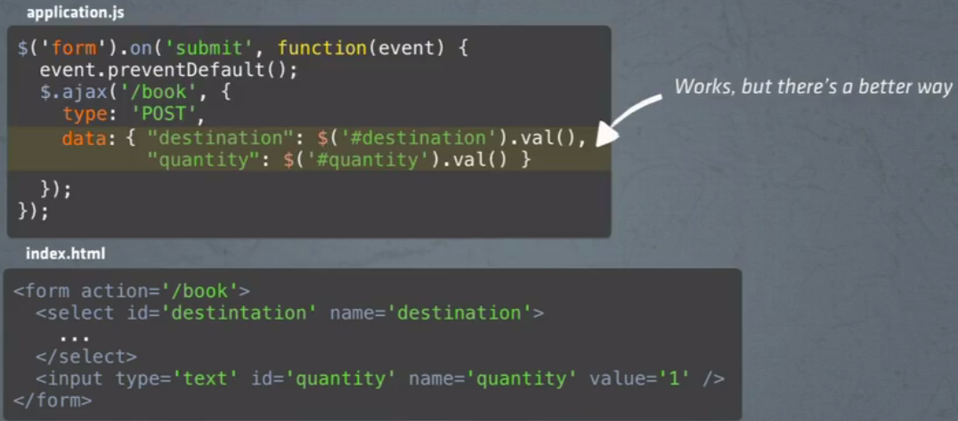
To send the data along with the request
Here event.prevent cuz the form has a default behaviour of full page refresh on form submit
On submit it did an ajax call and also submitted the form and did a full page refresh.
Here we send a key value pair wrapping it up into js object.

Slide 18
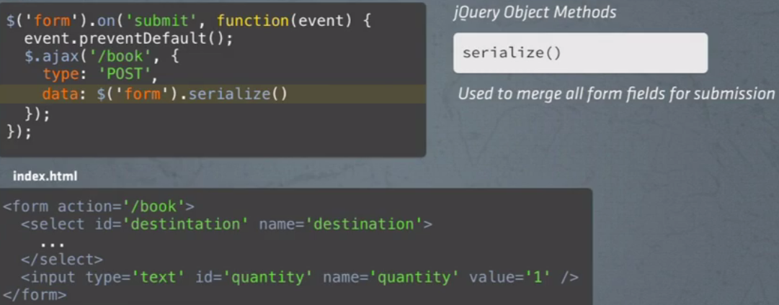
To send the data along with the request better way

Slide 19
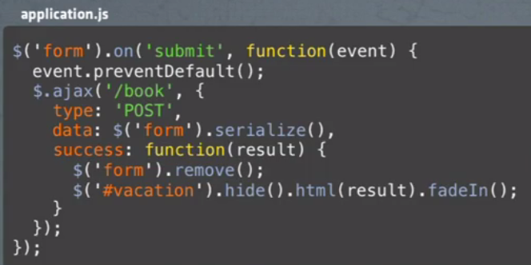
finally

Slide 20
JSON
JSON or JavaScript Object Notation is a lightweight text-based open standard designed for human-readable data interchange.
JSON stands for JavaScript Object Notation.
This format was specified by Douglas Crockford.
This was designed for human-readable data interchange
It has been extended from the JavaScript scripting language.
The filename extension is .json
This is primarily used to transmit data between server and web application.
Web Services and API.s use JSON format to provide public data.
Characteristics of JSON
Easy to read and write JSON.
Lightweight text based interchange format
Language independent.

Slide 21
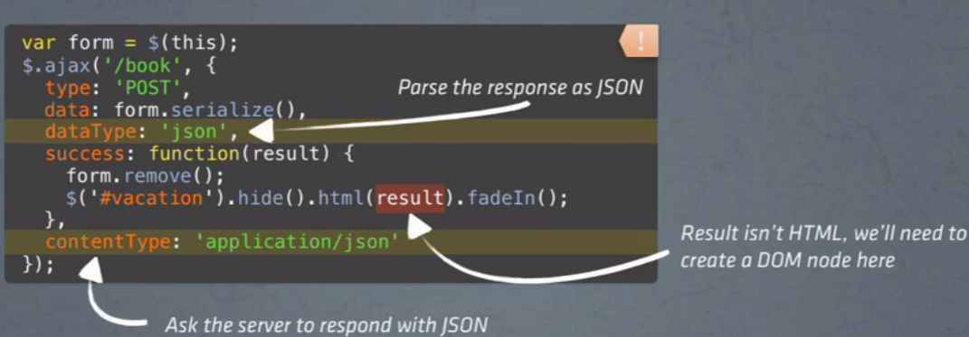
AJAX with JSON(JS object notation) a std way to format data
Use dataType option to tell the response we are expecting is a json and also use option contentType to ask the server to respond with json

Slide 22
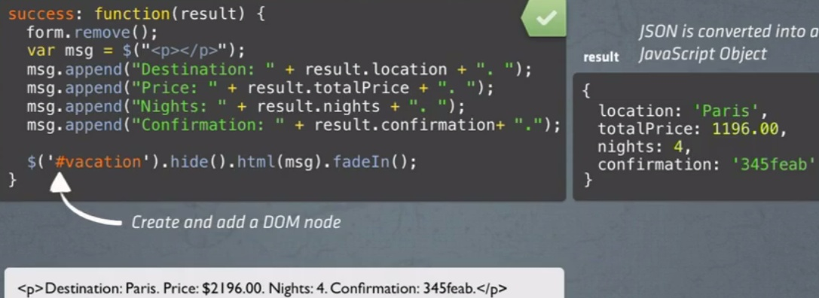
Instead of showing the json jus lidat convert it into html and den show

Slide 23
Namespace and trigger?

Slide 24
Custom events

Slide 25
Dont do plugins and promises

